Slide 1
SYNPUTER An Agile Approach
Andrea Paolo Gussoni
Emmanuel Eshun-Davies
Michael Botha
Wang Wang
Victoria Thompson

Slide 2
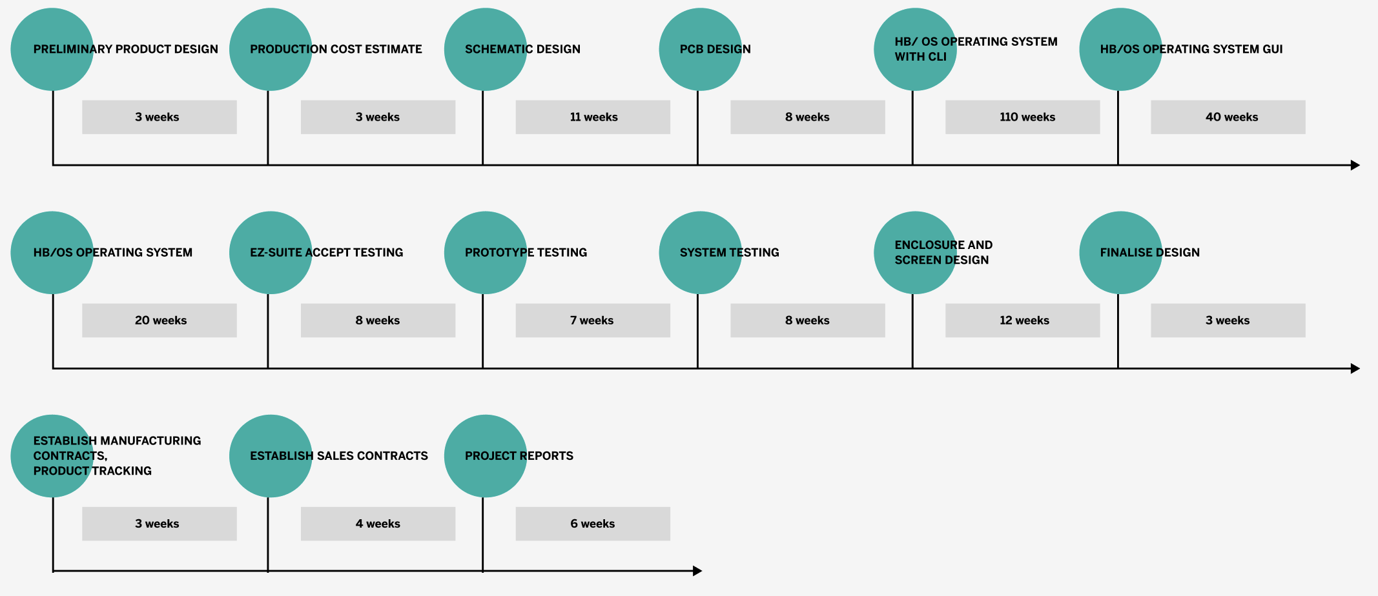
ORIGINAL PROJECT MILESTONES

Slide 3

EDC CONCERNS & SYN COMPUTING CHALLENGES
Industry standard operating system
External keyboard/connector
Minimum 512KB RAM
One industry standard removable drive
SCSI expansion support
Minimum 2 serial ports supporting RS 422/ 485
Minimum of 68000 CPU with upgradability
GUI & mouse supportability

Slide 4
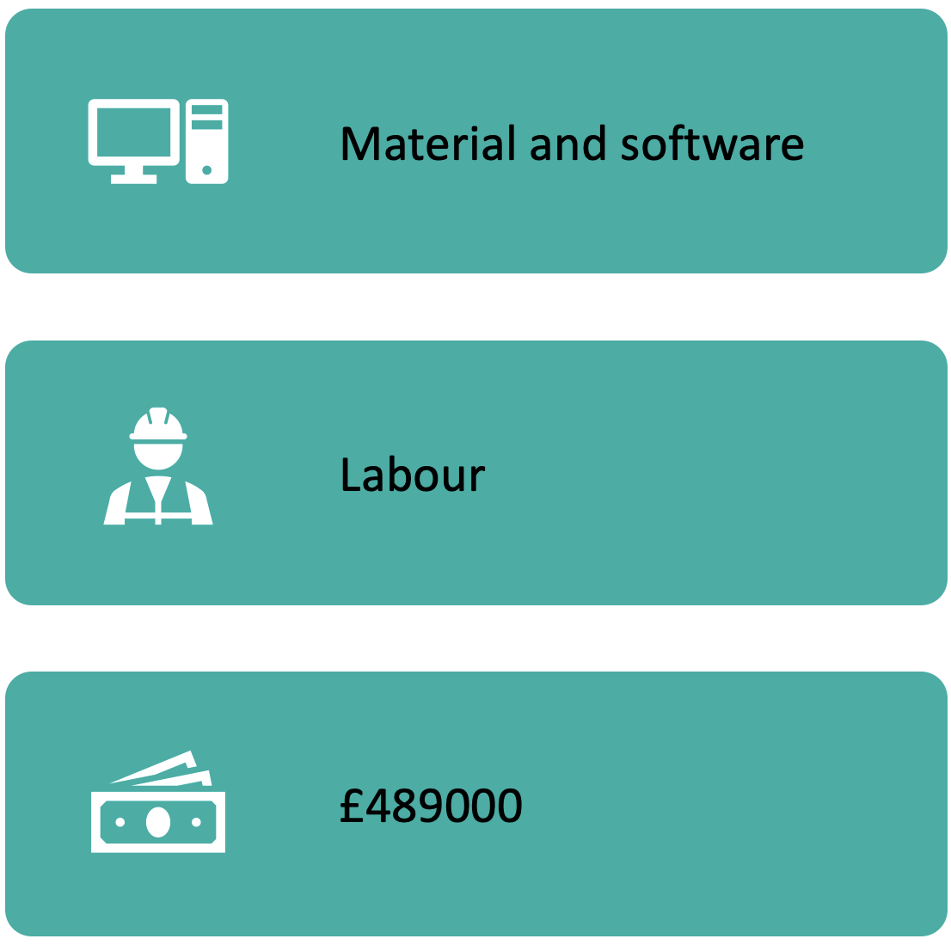
ORIGINAL BUDGET
Remaining budget:
£176 000

Slide 5
COST ADJUSTMENTS
Internal labour:
£35550
Outsourced labour:
£29650
Total:
£65200

Slide 6
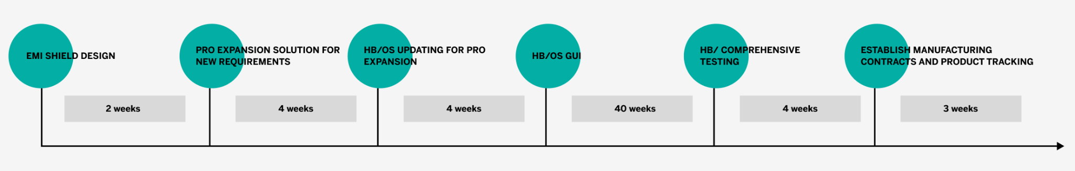
PROJECT DELIVERABLES
Inception
Proof of concept
Hardware adjustments
OS supporting hardware tasks
Comprehensive testing
1st December
14th December
28th December
11th January
15th February

Slide 7
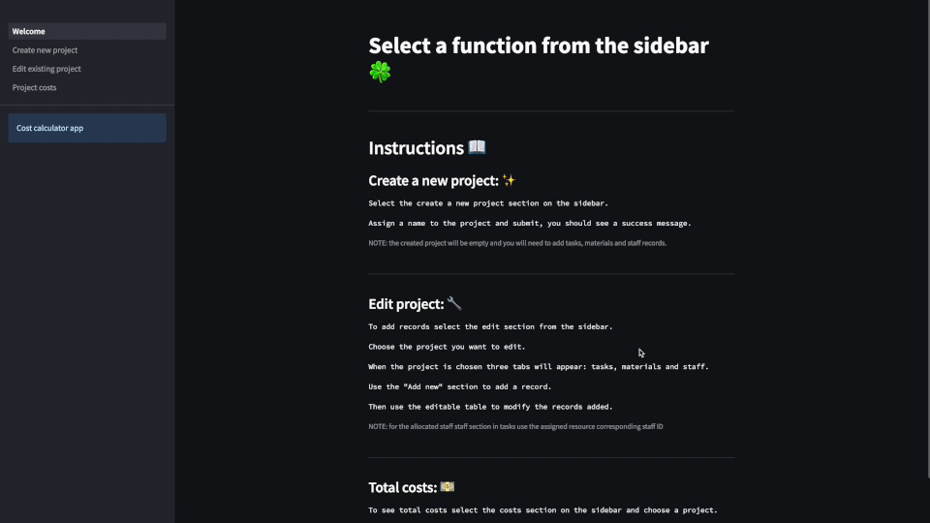
App Demo
Transcripts – App Demo
The application starts off with a quick list of instructions on how to use the application. Quite useful for new users. And already you can see from the instructions the 3 parts of the application. Creating a Project, Editing or managing the project and checking the Total costs that is generated from the entries on the edit project part.
For a first-time usage of the system, it is important to first create a project since the purpose of the application is to manage projects. So, we start of by going to the Create new project menu on the left side here.
There are 2 parts of this page, an option to create a new project and another to delete at the bottom here. Let’s now create a new project. Let’s call it “Synupter Hardware Project”. And then let’s submit to save it.
Now let’s check the bottom here to be sure it’s there. And it is there as you can see.
Next thing we want to do is explore the edit existing project page which is next on our menu.
On the edit project page, you can view and select available projects, The selected project will affect the rest of the process on this page. What this means is that whatever you do on this page will affect the selected project so be sure to select the right project before proceeding. We have for this page the options to add, view, edit and delete Tasks, Materials and Staff, all on the same page.
Let’s now select our newly created project from the previous page which is the “Synupter Hardware Project”. And as we can see, there are no tasks added yet. Now let’s add a new task by filling out the options for Task Description, 3 estimations and a chosen estimation and finally allocated staff.
Following the form, Let’s create about 4 different tasks. For hard drive, network port, mouse, and keyboard
And of course, there is the option to delete or edit any of the items we have added.
Now that we have added our tasks, let’s go on to add materials. The materials have same format as the add task page. Option to view, edit, add, and delete.
We will go ahead and add about 3 materials by entering a description for the material, number of materials required and the cost for each one. Let’s do this for Cables, resistors, and disks for our hard drive.
Now let’s look at our staff page which is also the same format. Edit, Add, and delete options.
Let’s add 5 new staff. The form here requires a designation and rate. Let’s do entries for an electrical engineer, V&V engineer, Lead Engineer. Quality Control and Safety Engineer
Now that we are done entering all the required parts for our project, we will go and see the project cost by selecting project costs at the menu.
A bit like the previous page, we must select our project which is the “Synupter Hardware Project”, and then we see the results.
So, picking an example for each table,
Total Staff cost for Hard Drive for instance chosen to estimate of 1,400 with 2 staff working on V&V processes at a rate of 45 is a total of 63,000
And for materials we have cables with a need of 100 of them at a unit cost of 23 is giving us a total cost 2,300
And of course, we can also see the total cost for project which is 370,000 and total cost for materials which is 13,640. And so, we seem to be working with expensive professionals in this example.

Slide 8
REFERENCES
IBM (2019). Planning, budgeting and forecasting. [online] Ibm.com. Available at: https://www.ibm.com/topics/planning-budgeting-and-forecasting.
Pmi.org. (2019). Fundamentals of scheduling & resource leveling. [online] Available at: https://www.pmi.org/learning/library/scheduling-resource-leveling-project-progression-8006.

